Slide 1
BIOCHEMISTRY
Presentation
BY HARAM TARIQ
BS TRANSFUSION MEDICINE
BATCH 2 (2022)
PRESNETED TO :SIR SHABBIR HUSAIN

Slide 2
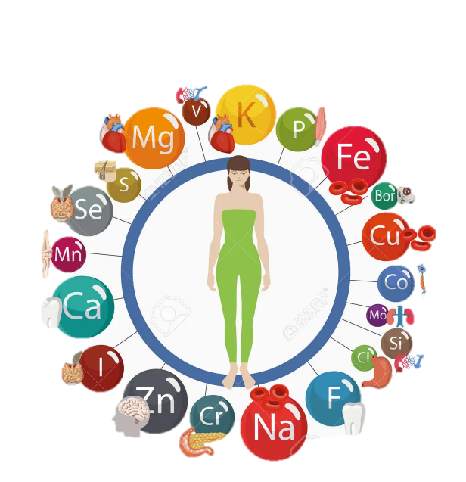
MINERALS
Minerals are naturally occurring inorganic nutrients present in food essential for normal body functioning
CLASSIFICATION
There are two kinds of minerals:
Macro minerals : more than 100 mg/day
Trace minerals : less than 100mg/day

Slide 3

Importance:
Minerals are important for your body to stay healthy.
Your body uses minerals for many different jobs, including ,
Bone and Tooth Health
Maintenance of body fluids
Energy Production
Nerve and Muscle Function
Immune Health
Tissue building
Maintain proper pH in body fluids
Maintenance of metabolism
Making Enzymes and Hormones.
Most people get the amount of minerals they need by eating a wide variety of foods. In some cases, your doctor may recommend a mineral supplement. People who have certain health problems or take some medicines may need to get less of one of the minerals. For example, people with chronic kidney disease need to limit foods that are high in potassium.

Slide 4
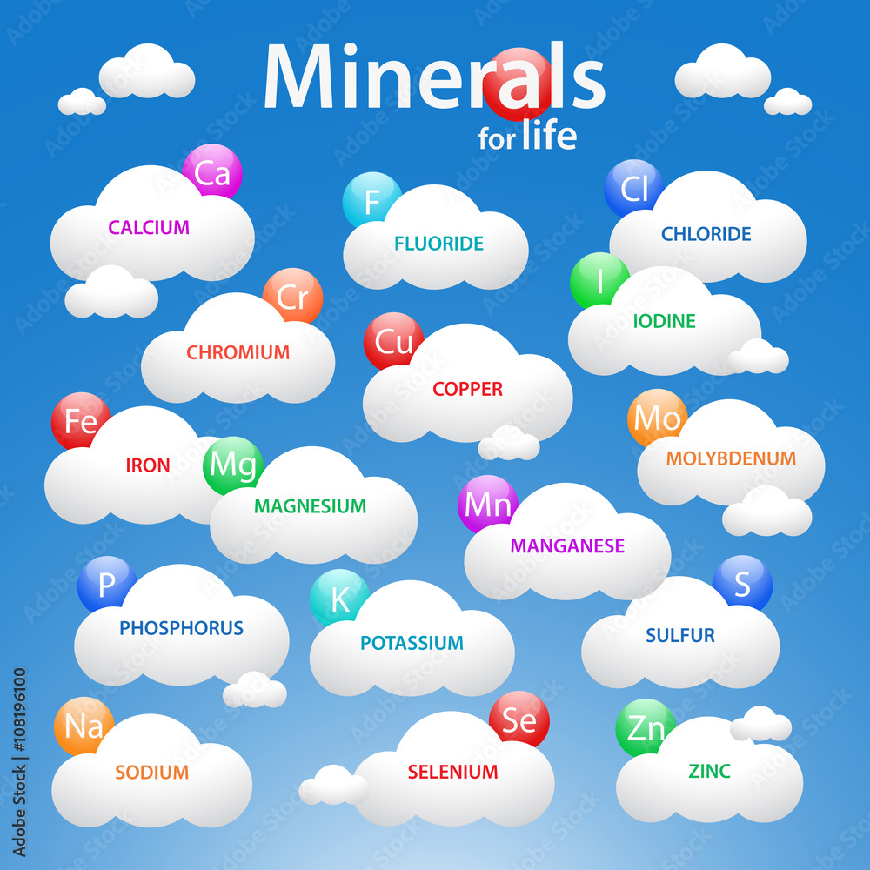
Macro-minerals
The importance of minerals does not depend on their amounts in the body ,
There 7 in number,
Their names with % body ratio are,
Calcium (2%)
Phosphorus (1%)
Potassium (0.3%)
Sulfur ( 0.2%)
Sodium (0.1%)
Chloride (0.1%)
Magnesium (0.05%)
Iron (0.04%)

Slide 5
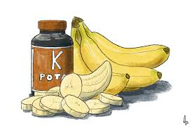
POTASSIUM(K)
Potassium is the major intra cellular cation .
It is found in both plants and animals
It is present in human body as K+ ,whilst
Common inorganic ions are Cl , HPO4 , citrate , tartrate, bicarbonate
Common organic ions are gluconate

Slide 6
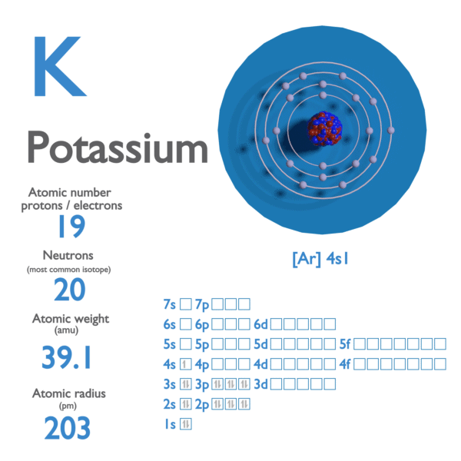
Properties
DISCOVERY
Potassium was the first metal to be isolated by electrolysis, by the English chemist Sir Humphry Davy, when he obtained the element (1807) by decomposing molten potassium hydroxide (KOH) with a voltaic battery.
MELTING POINT | 63.28 °C
BOILING POINT | 760 °C
SPECIFIC GRAVITY | 0.862 (at 20 °C)
DENSITY | 0.856g/mL
OXIDATION STATE | +1, −1 (rare)

Slide 7
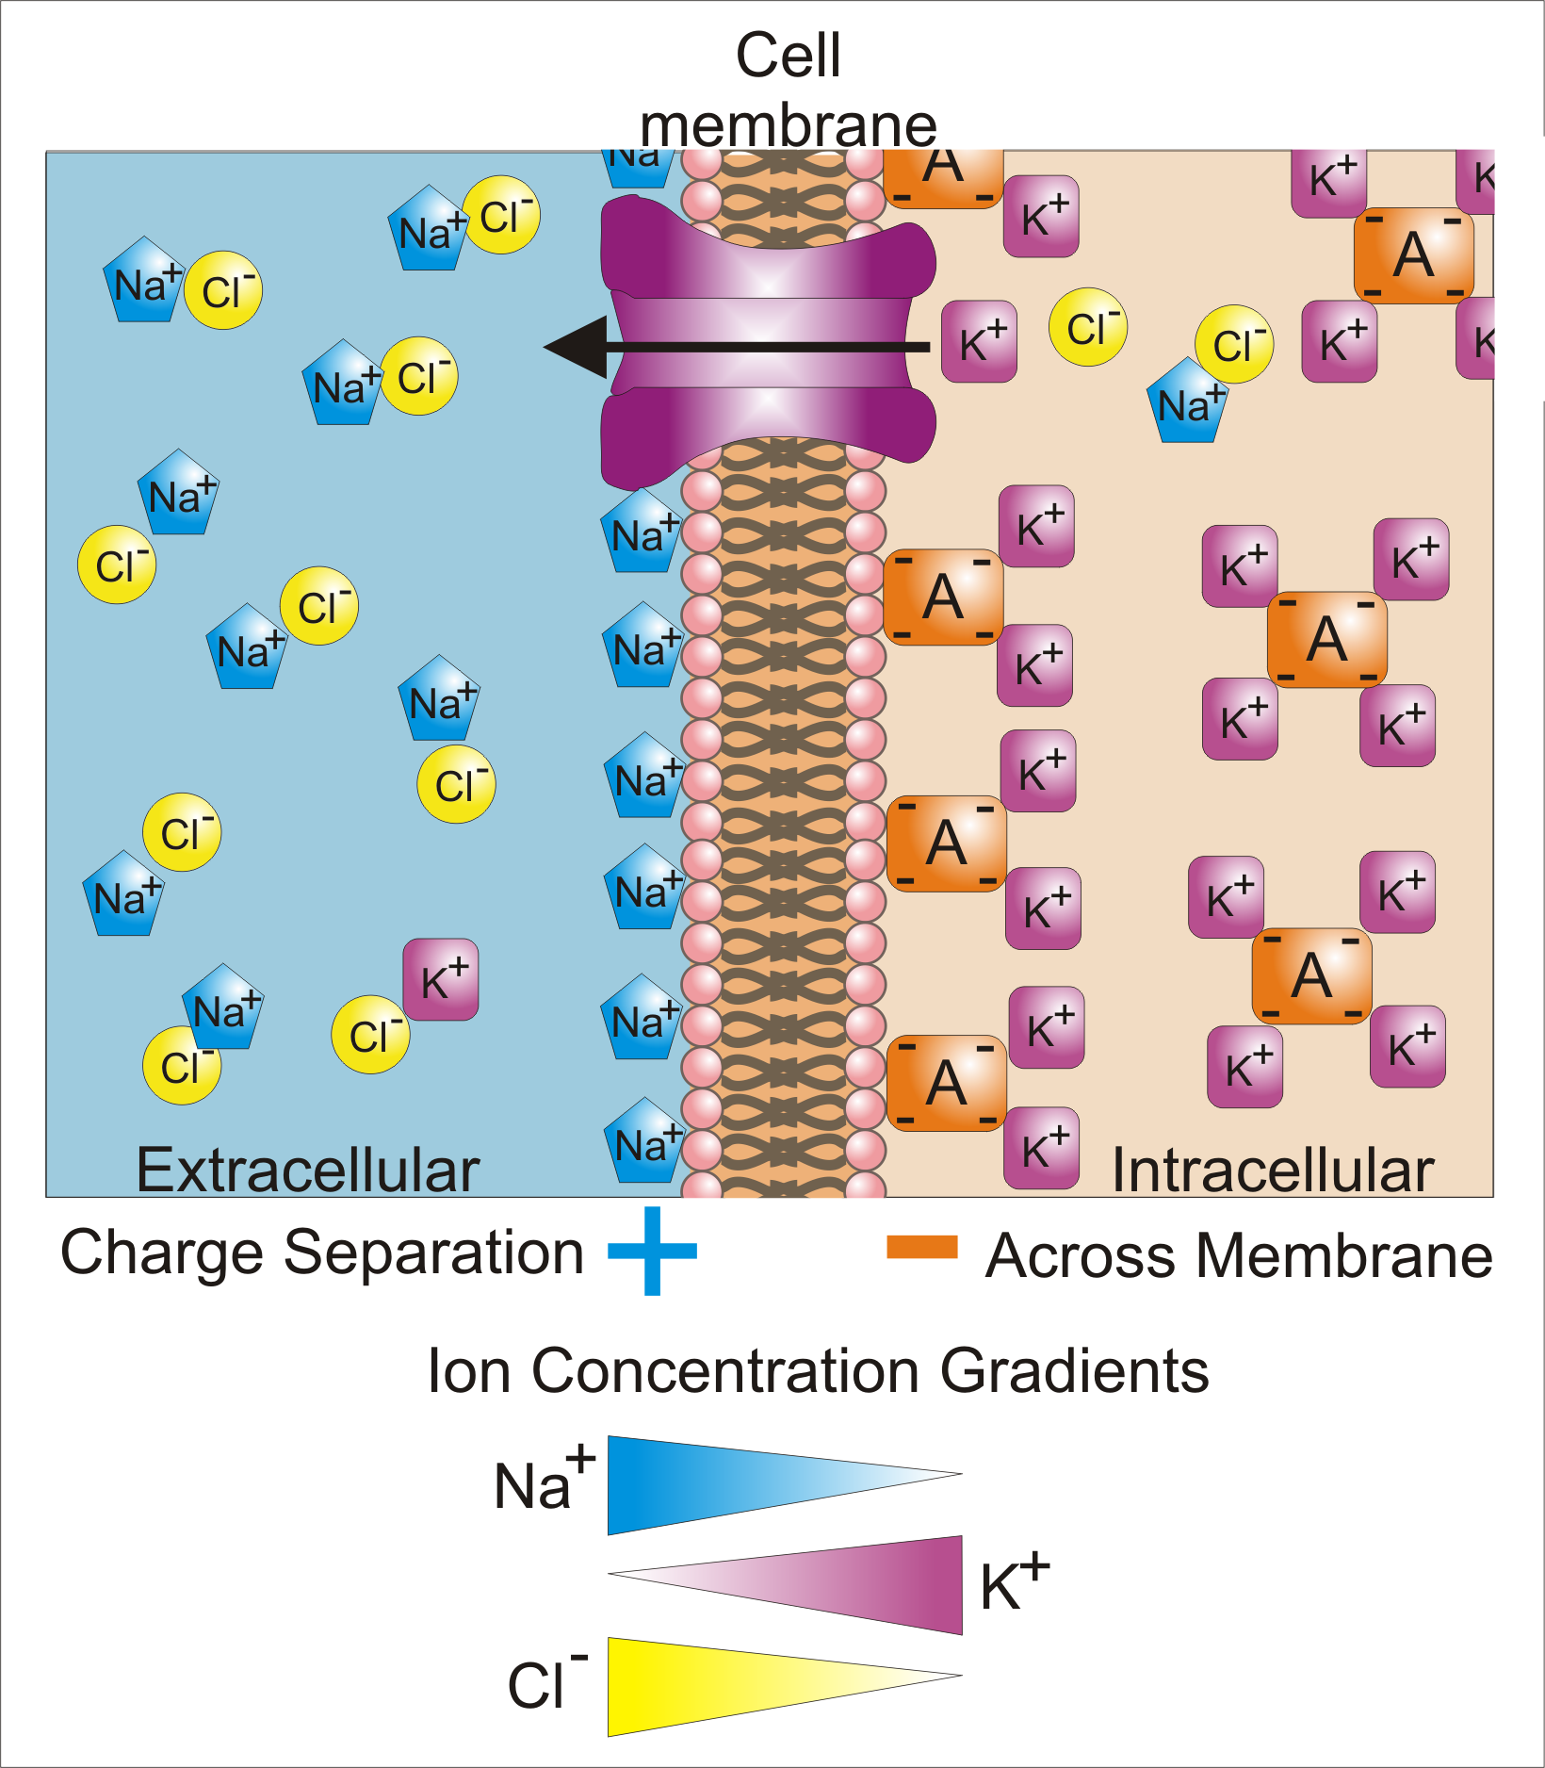
Plasma levels
Its body content is about 3500mEq , out of which 75% is in skeletal muscles.
It exists predominantly in the intracellular fluid at concentrations of 140 to 150 meq/liter
(And)
in the extracellular fluid at concentrations of 3.5 to 5 meq/liter.

Slide 8
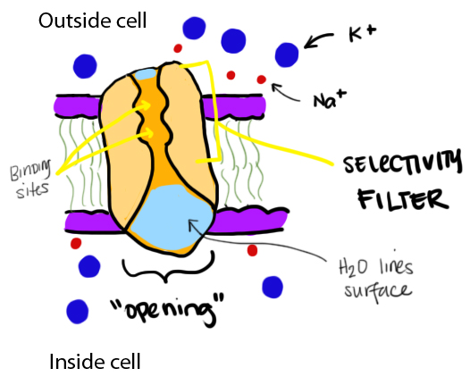
Functions
Potassium is very important in the human body.
Along with sodium, it regulates the water balance and the acid-base balance in the blood and tissues. Potassium enters the cell more readily than does sodium and instigates the brief sodium-potassium exchange across the cell membranes.
In the nerve cells, this sodium-potassium flux generates the electrical potential that aids the conduction of nerve impulses. When potassium leaves the cell, it changes the membrane potential and allows the nerve impulse to progress.

Slide 9
The electrical potential gradient, created by the "sodium-potassium pump," helps generate muscle contractions and regulates the heartbeat.
Another of the pump's most important functions is preventing the swelling of cells. If sodium is not pumped out, water accumulates within the cell causing it to swell and ultimately burst. Potassium is very important in cellular biochemical reactions and energy metabolism;
It participates in the synthesis of protein from amino acids in the cell.
Potassium also functions in carbohydrate metabolism
it is active in glycogen and glucose metabolism, converting glucose to glycogen that can be stored in the liver for future energy.
Potassium is important for normal growth and for building muscle. Though sodium is readily conserved by the body, there is no effective method for potassium conservation. Even when a potassium shortage exists, the kidneys continue to excrete it. Because the human body relies on potassium balance for a regularly contracting heart and a healthy nervous system, it is essential to strive for this electrolyte's balance.

Slide 10
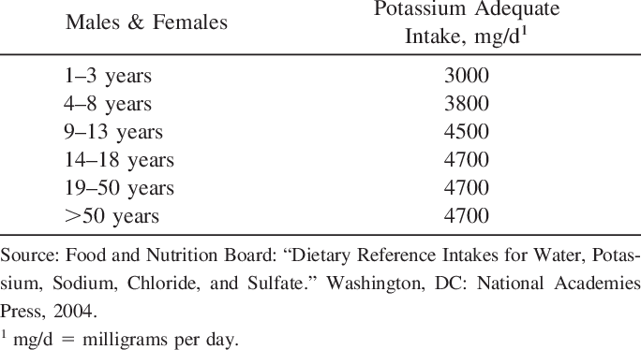
Requirements
Recommended Dietary Allowance for potassium is 2 to 5 gm/day
People at risk for insufficient potassium intake include alcoholics, drug addicts and crash dieters.

Slide 11
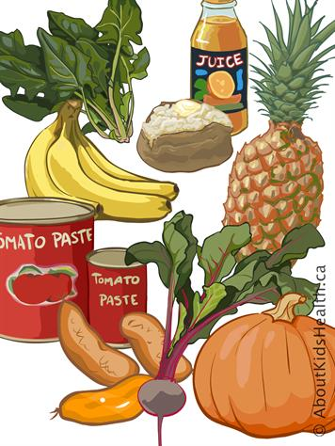
Sources
Potassium is found in a wide range of foods.
Many fruits and vegetables are high in potassium and low in sodium and help prevent hypertension.
Leafy green vegetables such as spinach, parsley, and lettuce peas, lima beans, tomatoes, and potatoes, especially the skins, all have significant levels of potassium.
Fruits that contain this mineral include oranges and other citrus fruits, bananas, apples, avocados, raisins, and apricots, particularly dried.

Slide 12
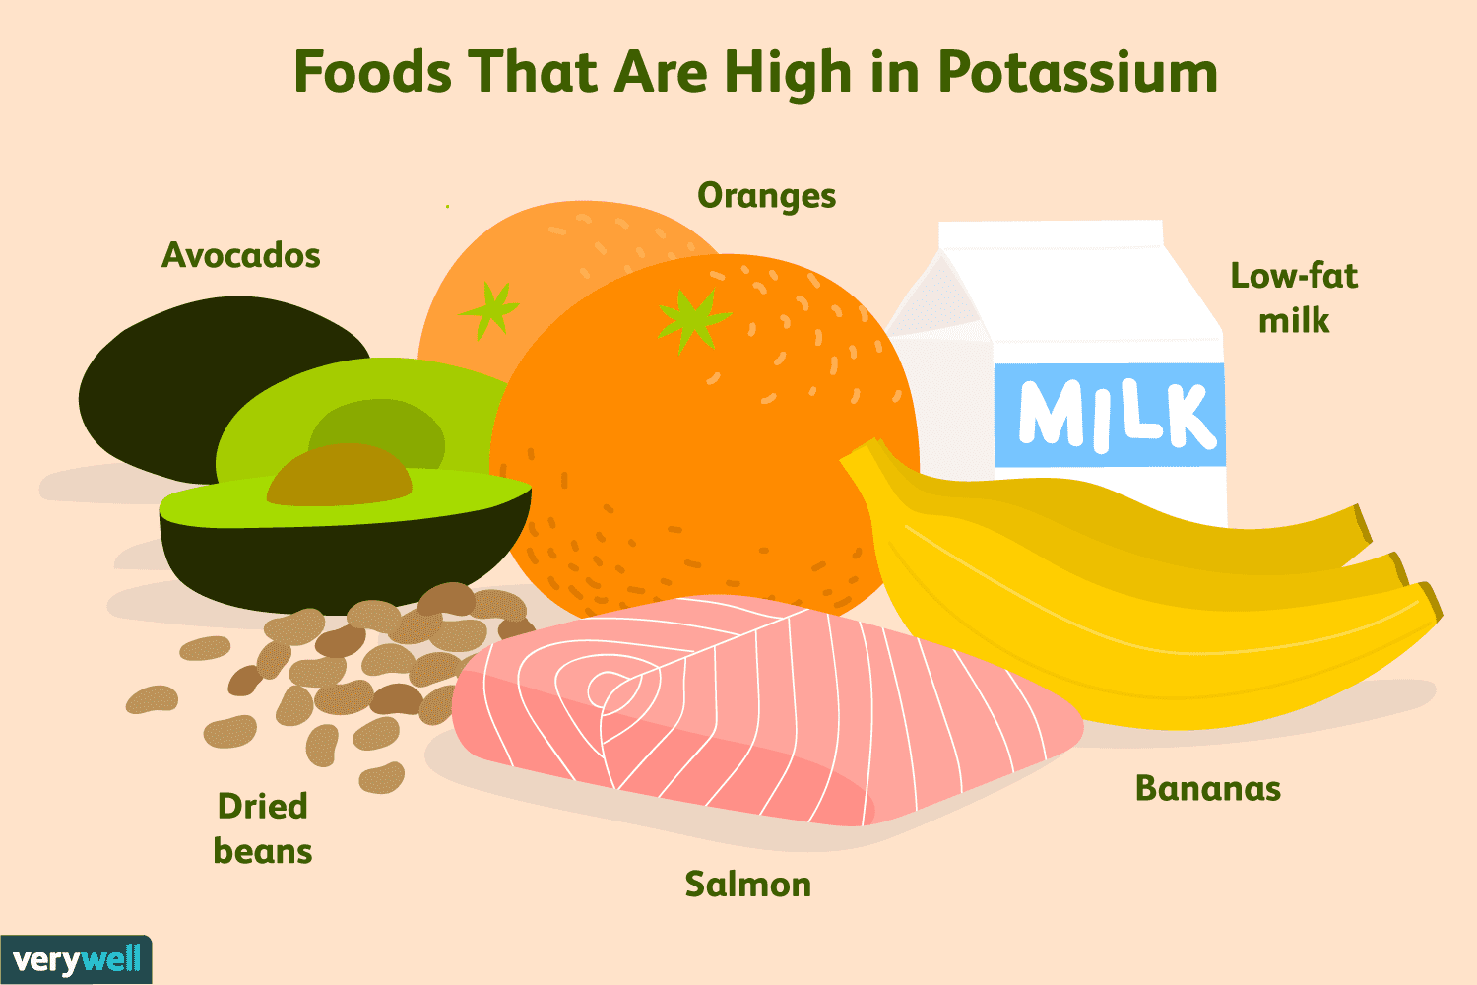
Whole grains, wheat germ, seeds, and nuts are high-potassium foods.
Fish such as flounder, salmon, sardines, and cod are rich in potassium, and many meat foods contain even more potassium than sodium, although they often have additional sodium added as salt.
Herbs containing it are red clover, sage, catnip, hops, horsetail, nettle, plantain and skullcap.
Caffeine and tobacco reduce the absorption of potassium.

Slide 13
Absorption and Excretion
The amount of potassium in the body depends on the balance between potassium intake and output
Absorption:
Potassium is readily absorbed by passive diffusion from gastrointestinal tract. .
Excretion
Potassium output occurs through three primary routes, the gastrointestinal tract, the skin and the urine.
Under the normal conditions loss of potassium through gastrointestinal tract and skin is very small i.e (10%)
The major means of potassium excretion is by the kidney. i.e (90%)

Slide 14
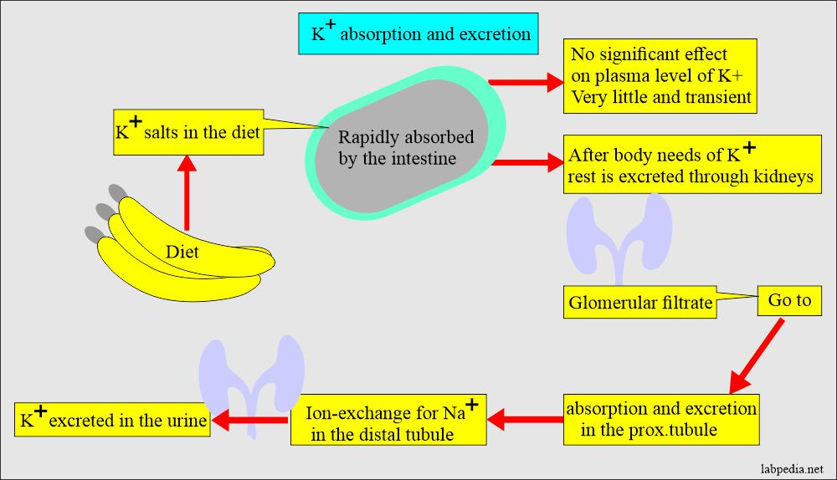

Slide 15
Potassium Homeostasis
Potassium homeostasis denotes the maintenance of the total body potassium content and plasma potassium level within narrow limits in the face of potentially wide variations in dietary potassium intake.
Potassium homeostasis involves redistribution of potassium between cells ICF and the ECF.
It involves two concurrent processes —
external balance
internal balance
d
The kidney is the seat of the body’s K+ metabolism and it maintains the body’s K⁺ content by controlling K⁺ intake and K⁺ excretion/loss.
Another organ involved in K⁺ homeostasis is the colon. The colon is the major site of gut regulation of potassium excretion.
In skeleton muscles , Na-K pumps are play a role in it.
Genes involved in K⁺ homeostasis are WNK genes.

Slide 16
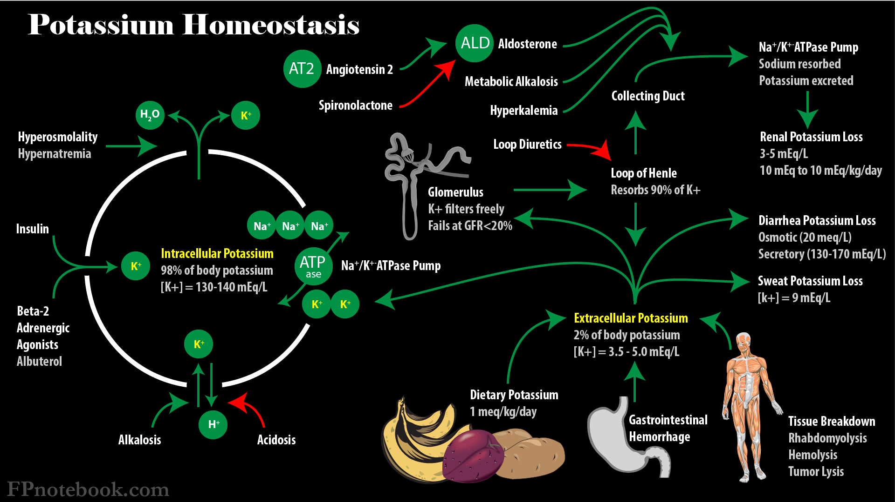

Slide 17
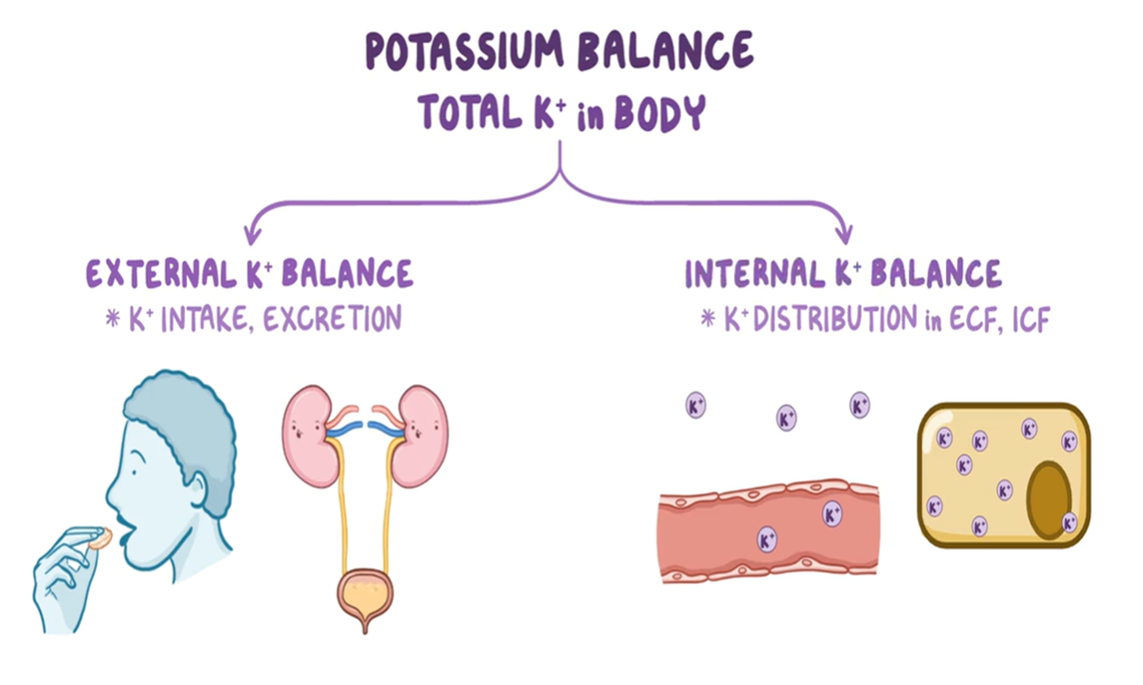
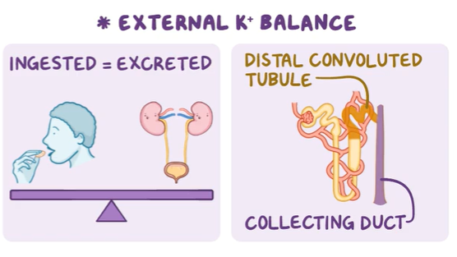
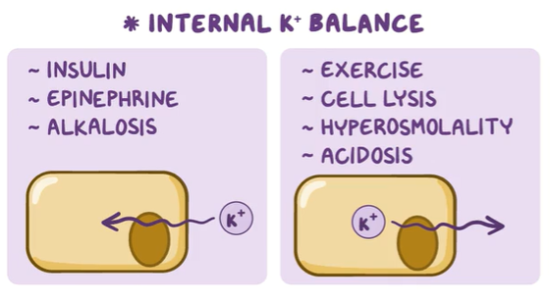

Slide 18
Potassium Imbalance
Major conditions associated with potassium imbalance which causes different health abnormalities and diseases are.
Hypokalemia
Abnormal low blood potassium level of < 3.5 mEq/L is referred to as hypokalemia and it is a common electrolyte disorder in clinical practice.
Hyperkalemia
Hyperkalemia is defined as a serum potassium > 5.5 mEq/L, the normal range is 3.5–5.5 mEq/L for adults .
Pseduohyperkalemia
Pseduohypoaldosteronism
Diagnosis:
By routine blood test
However, It is important that you tell your healthcare provider about all the medicines you take, even over-the-counter products such as herbals and other supplements.

Slide 19
Hypokalemia
CAUSES
Gastrointestinal losses:
Alkalosis:
An alkalosis may cause a shift of potassium from the ECF to the ICF.
kidney disease
overuse of diuretics
excessive sweating, diarrhea, and vomiting
Magnesium deficiency
use of antibiotics, such as carbenicillin and penicillin
SYMPTOMS
They include anorexia, nausea, vomiting, muscle cramps, or tender ness, electrocardiographic changes, polyuria, polydipsia, lethargy and confusion

Slide 20
EFFECTS
Muscle Cramps
Congestive Heart Failure (CHF):
Congestive heart failure (CHF) is a condition in which the heart's function as a pump is inadequate to meet the body's needs.
The symptoms of congestive heart failure vary, but can include: fatigue, diminished exercise capacity, shortness of breath, and swelling (edema).
Diarrhea:
Dehydration
Premature Ventricular Contractions (PVCs):
Premature ventricular contractions (PVCs) are premature heartbeats originating from the ventricles of the heart. Premature ventricular contractions are premature because they occur before the regular heartbeat.

Slide 21
Gastroenteritis (Stomach Flu):
Gastroenteritis (often referred to as the "stomach flu") however, it is not related to the influenza virus. Gastroenteritis is a nonspecific term for various inflammatory problems in the gastrointestinal tract. It is occurred due to lack of Potassium.
TREATMENT
Potassium-sparing diuretics can rid the body of excess sodium. This will help normalize electrolyte levels. But, some diuretics and potassium supplements can be harsh on the digestive tract.

Slide 22
Hyperkalemia
CAUSES
Mineralocorticoid deficiency
e.g. Addison’s disease.
severe dehydration
intravenous administration of fluids with excessive potassium salts.
Cell damage
e.g. in rhabdomyolysis (a condition in which damaged muscle cells release myoglobin), trauma and malignancy.
taking too many potassium supplements
kidney disease
prolonged exercise
cocaine use
potassium-conserving diuretics
chemotherapy
severe burns

Slide 23
SYMPTOMS:
First manifestation is cardiac arrest, changes in electrocardiogram, cardiac arrhythmia and muscle weakness.
EFFECTS
If left untreated, high potassium levels can lead to the following complications:
weakness
arrhythmia, a heart disorder that affects the rate or rhythm of your heartbeats
heart attack
cardiac arrest, an extremely serious condition where your heart stops beating

Slide 24
TREATMENTS
Use of diuretics
Enema
Dialysis
Albuterol inhaler
Significance
In medicine, potassium is one of the most commonly prescribed minerals. It is also commonly measured in biochemical testing and is supplemented if it is low. It is suggested that we include more potassium than sodium in our diets; a ratio of about 2:1 would be ideal.

Slide 25
THANK YOU

